Slide 1


Slide 2



Slide 3
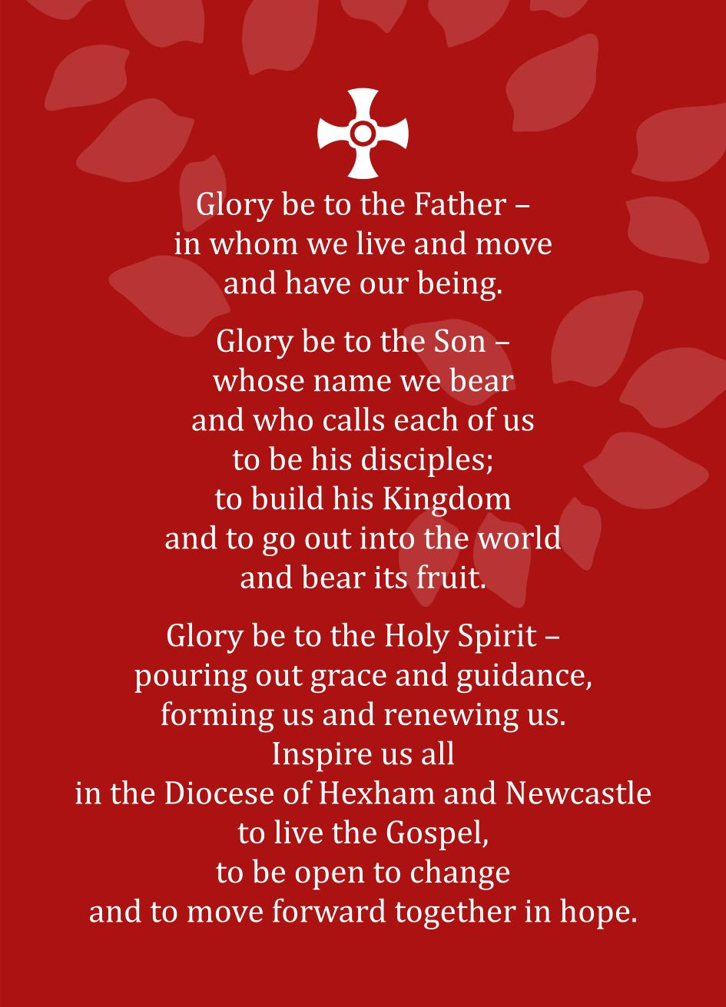
Notes:
The Forward Together in Hope Prayer

Slide 4
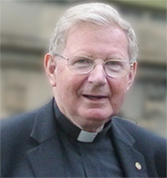
About Forward Together in Hope
‘The purpose of Forward Together in Hope is to help us discover how to be more committed disciples of Jesus Christ. It will also help us find a way of making best use of our resources in order to ensure we have a thriving and sustainable Catholic community into the future.’
Notes:
About Forward Together in Hope
The quote here is an extract from the Foreword by Bishop Séamus at the front of the ‘Exploring the Way’ Booklet where he leads and endorses the Forward Together in Hope process.
He sets out the purpose of Forward Together in Hope as primarily helping us to discover how to become more committed disciples of Jesus. He also highlights the task of seeking to make best use of our resources to ensure that Catholic communities are sustainable and thrive into the future.

Slide 5


Some Principles
Firmly rooted in prayer
Clergy and lay people working together
Open, transparent and fair
Excellent communication
Clarity of decision-making
Inclusive and collaborative
Celebrating success
Sharing good practice
Notes:
Some Principles
These principles are fairly self-explanatory but they attempt to ‘set out the stall’ of how we wish to operate within Forward Together in Hope.
The message that we are trying to give is that while this process is far-reaching and might well be painful and difficult at times we want it to be as open and transparent as possible. We will aim to communicate well throughout the work and make clear the way decisions will be arrived at.
Part of the process of self-evaluation and reflection will help us identify what is working well and give us opportunities to celebrate success and share good practice.

Slide 6

The 3 Stages of the Journey
Preparing the Way (Autumn 2014-Spring 2015 )
  Developing liturgies and prayer resources
  Developing and distributing information leaflets
  Informing everyone about the approach through meetings, documents and a DVD
  Initial meetings and training for clergy and laity
  Bishop Séamus leads days of reflection
Notes:
The 3 Stages of the Journey
We have described the Forward Together in Hope process as three stages on a journey - Preparing the Way; Exploring the Way and Pointing the Way
The overall ‘map’ and timescales for the journey are shown in the diagram on the inside front cover of the ‘Preparing the Way’ Booklet.
Of course, a journey like this can never really end, but we hope that after 3 years we will have discovered some key indicators regarding the future of the Diocese and have started to put the new arrangements in place.
Over the next 3 slides some of the key elements of each of the stages of the journey are set out. Most of these are self-explanatory so only the key messages are highlighted here:
a) Preparing the Way
This was very much a stage of everyone finding out about Forward Together in Hope and preparing for the journey ahead.
The key aspect at parish level is to put in place a range of communication methods to get people geared up and involved.

Slide 7
The 3 Stages of the Journey
Exploring the Way (Spring 2015-Summer 2016)
  Prayer and liturgies across the Diocese
  Providing unique data to each parish at Pentecost
  Extensive consultation and self-evaluation process in each worshipping community
  Return of completed self-evaluation questionnaire and recommendations by Advent
  Detailed analysis and validation of responses
  Clarification meetings and on-going discussions
Notes:
The 3 Stages of the Journey
b) Exploring the Way
The work at parish level really starts in earnest in May 2015 – around Pentecost. Every worshipping community has received a detailed self-evaluation questionnaire to be completed by the beginning of Advent.
They have also received a pack of data with details about their community extracted from information held centrally by the Diocese.
Between Pentecost and Advent, each worshipping community will look in detail at how best it can flourish into the future. The invitation to every community is to be both painstaking and honest in its approach to a self-evaluation questionnaire.

Slide 8

The 3 Stages of the Journey
Pointing the Way
  Prayer and liturgies across the Diocese
  Consideration of recommendations by Diocesan-wide group of clergy and laity
  Information and analysis made available to Bishop Séamus to take decisions about the future
  Communicating these decisions and indicating the way forward for everyone
  Supporting parishes in moving to the new arrangements
Notes:
The 3 Stages of the Journey
c) Pointing the Way
One of the key aspects of the Forward Together in Hope process is that of openness and transparency. To help ensure that this is the case it is proposed that once all information is collected the results will be looked at carefully by a wide-ranging group of priests and people so that their views and perspectives can help finalise the indications, pointers and recommendations for the Bishop.
The diagram and narrative on Page 18 of the original ‘Preparing the Way’ document set out more details.

Slide 9

Questionnaire – Key Headings
Education and Continuing Formation
Active Involvement of People
Worship and Spiritual Life
Geographic Distance
Christian Faithful
Young People
Leadership
Outreach
Finances
Facilities
Notes:
Questionnaire Headings
The sections of the self-evaluation questionnaire has the key headings shown in this slide. They are presented here randomly – and around the tree – so as not to suggest that any one area is more important than another.
On pages 14-17 of the original ‘Preparing the Way’ document there is more detailed information about each area.

Slide 10


Exploring the Way – Parish Questionnaire
Part A
Detailed questions - 10 key headings
Supported by Data Pack
Part B
Reflective questions - same 10 headings
What else?
Good Practice
Part C
Initial thoughts and ideas about the future
Notes:
Parish Questionnaire
The details of the 3 part questionnaire are set out in full in the Exploring the Way Booklet.

Slide 11
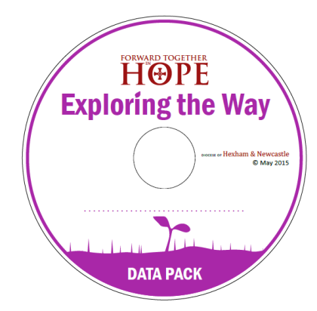

Exploring the Way – Data Pack
Data Pack
Follows same headings as questionnaire
Unique to each parish
Summary information about the parish held by the Diocese
Intended to support exploration and consultation process in communities
Openness and transparency
Notes:
Data Pack
A unique Data Pack has been provided to each Parish. It contains summary data held centrally by the Diocese.
It is intended to assist the process of the parish community getting a clear picture of where it stands in relation to the 10 key headings within the questionnaire. It is available on a Data Pack CD and in hardcopy.

Slide 12

From Pentecost to Advent
Main tasks for each community will be:
Gathering and exploring data and information to inform Part A
Involving everyone in considering the Reflective Questions that feature in Part B
Collecting and summarising initial thoughts and ideas that the community has about its future direction for Part C
Notes:
From Pentecost to Advent
The 6 months between Pentecost and the beginning of Advent will be a critical time for the Forward Together in Hope process.
This slide highlights the main tasks that each community will need to address. The Exploring the Way booklet goes into more details.

Slide 13

A Possible Approach
Inform everyone about what will be happening using the Exploring the Way information sheet
Establish a small group to look at the data and other parish information and draft the responses for Part A
Develop a summary picture of the data for everyone
Run open meetings to:
  Present the data
  Discuss Reflective Questions in Part B
Produce a statement about initial ideas for the future in Part C of the questionnaire
Notes:
A Possible Approach
Each Parish will wish to approach the process in the way that is right and realistic for them. The Exploring the Way booklet has a suggested approach – and this slide summarises this.

Slide 14

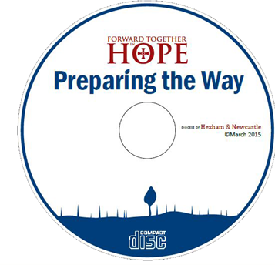
Exploring the Way Resources
Exploring the Way booklet
Summary Handout for everyone
Parish Questionnaire
Data Pack
Prayer and Liturgy Resources
All items (except Data Pack) also on CD and website at: www.hope.rcdhn.org.uk
Notes:
Preparing the Way Resources
At each stage of the journey, resources will be made available to support parishes. A ring-binder file has been made available to all priests and lay representatives containing the initial resources and as a place to store subsequent information about Forward Together in Hope.
Key documents for the Exploring the Way stage are highlighted in this slide. The Summary Handout is a useful 2-side document that can be made easily available to everyone.
Most documents will also be made available on the Diocesan website at www.hope.rcdhn.org.uk

Slide 15

Contacts and Support
Lay contact in each parish to help communicate and support the process
All resources and latest news on the website www.hope.rcdhn.org.uk
Forward Together in Hope Team available on
  Email: hope@diocesehn.org.uk
  Tel: (0191) 243 3304
Notes:
Contacts and Support
The importance of good information and communication throughout the process is vital and this slide is a reminder of the website and e-mail contacts for the Forward Together in Hope team.

Slide 16

I firmly believe that the Holy Spirit is with us, giving us the courage we need to move forward together in hope.
Notes:
And finally…
This slide shows the front of the Forward Together in Hope prayer card and highlights Bishop Seamus’ belief that we are being guided by the Holy Spirit throughout the Forward Together in Hope journey.

